Slide 1
Math 10 Honours Chapter 7 Review Probability

Slide 2
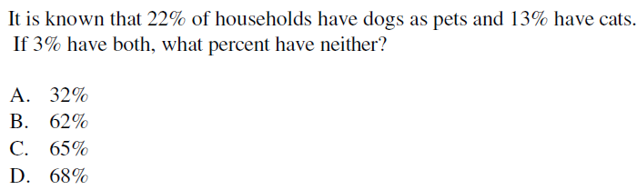
Draw a Venn Diagram with 2 circles:
D
Dogs
Cats
Take 100% and subtract the percentages above
68% of the people surveyed have neither pets

Slide 3
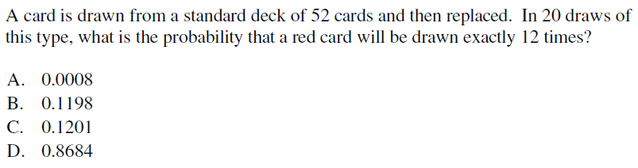
C
This is a binomial expansion because there are only two outcomes: Red and Black
Since each card is replaced, each draw will be an
Independent event

Slide 4
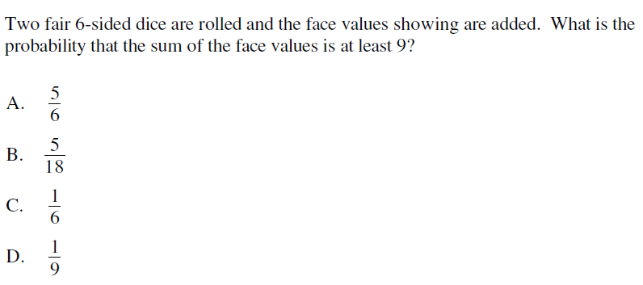
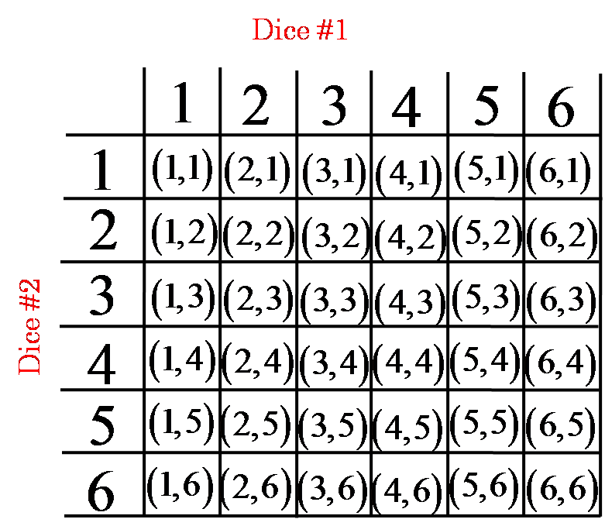
B
Create a dice chart
Circle the ones that have atleast 9
10 out of 36 cases have atleast a sum of 9

Slide 5
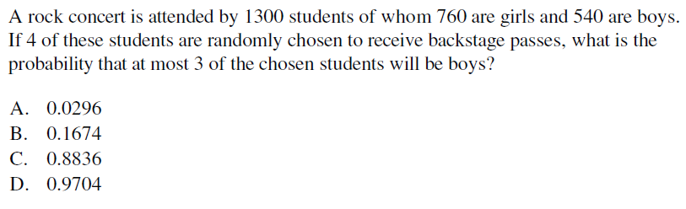
At most 3 boys will include several cases:
D
Zero boys, 1 boy, 2 boy, and 3 boys
The compliment event will be having all 4 boys

Slide 7
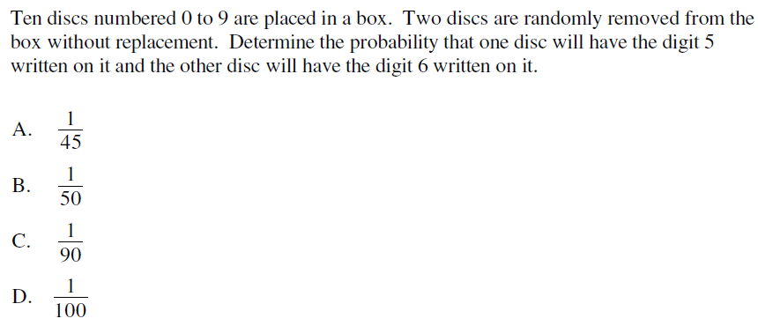
A
There is no replacement, so the events are dependent. Create a tree diagram
The probability of getting a 5 then a 6 will be:

Slide 8
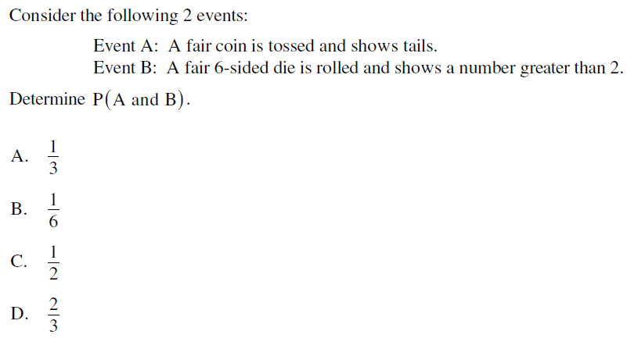
The two events are independent, so:
A

Slide 9
With this question, start small and grow big
Suppose you have only 1 slot
Suppose you have only 2 slot
Suppose you have only 3 slot
Suppose you have only 4 slot
What patterns do you notice?

Slide 10
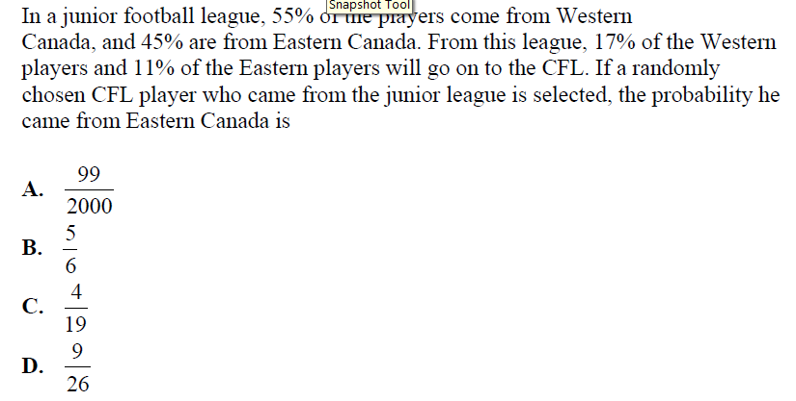
D

Slide 11
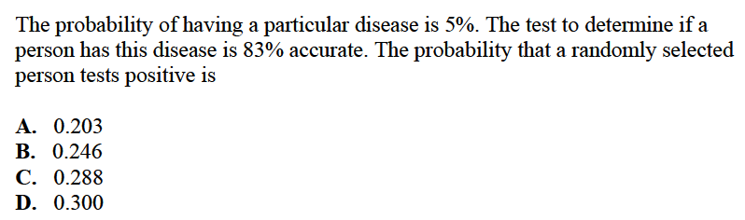
A

Slide 12
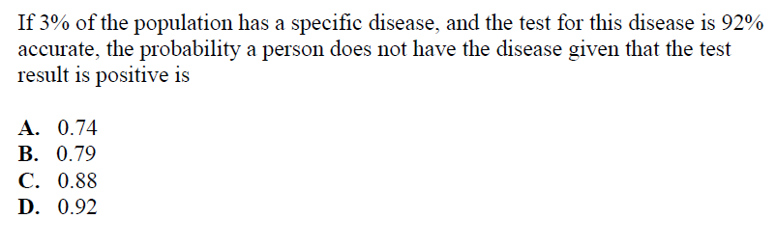
A

Slide 14
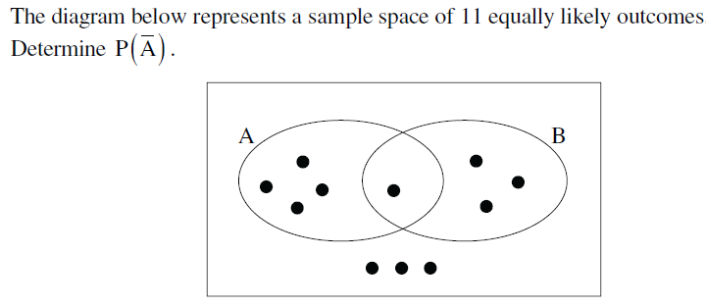
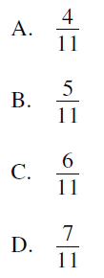
C
6 out of 11 dots are not in circle A

Slide 15
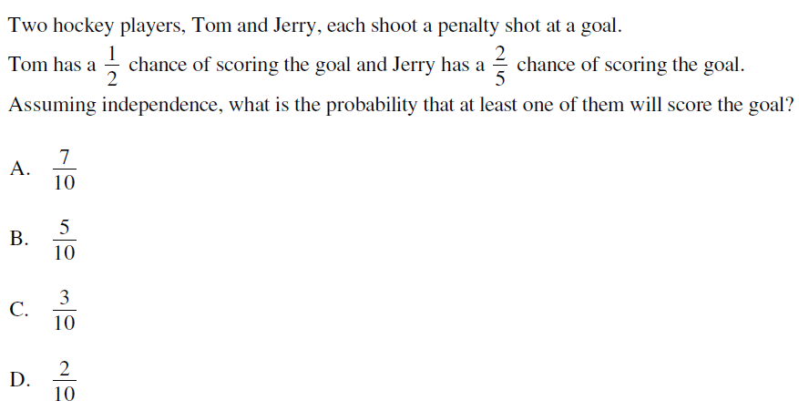
There are four possible cases:
1. Tom scores and Jerry scores
A
2. Tom misses and Jerry scores
3. Tom scores and Jerry misses
4. Tom misses and Jerry misses
Atleast one of them will score will include cases 1, 2, and 3

Slide 16
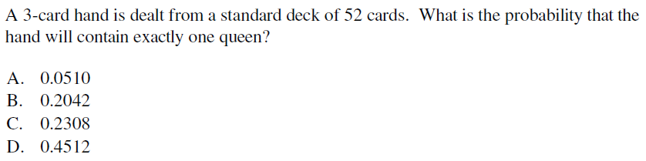
B
There are 4 queens and 48 other cards
Since there are 2 categories, use the bucket method

Slide 17
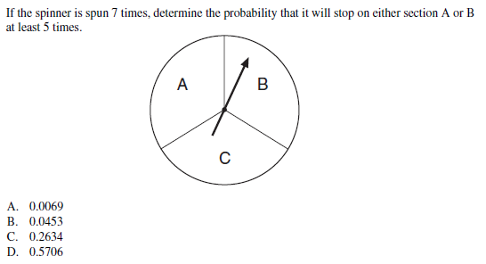
The probability of getting an A or B is 2/3
Getting atleast 5 times will include
getting it 5, 6 and 7 times
D

Slide 18
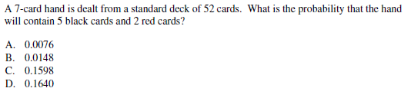
Use the bucket method because there are 2 categories
C
Total number of desired hands
Total number of possible hands

Slide 19
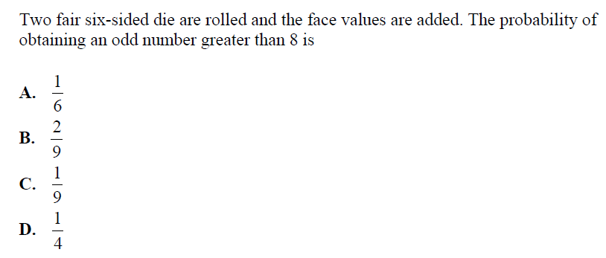
A
Create a dice chart
Circle the odd sums greater than 8
6 out of 36 cases have an odd sum greater than 8

Slide 20
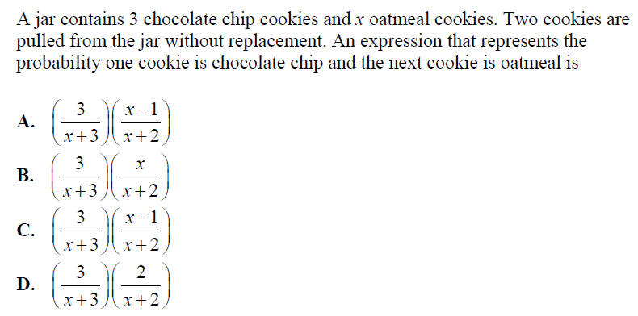
Number of Chocolate chips: 3
Number of oatmeal cookies: x
Total number of cookies: x+3
Use the tree diagram to get a chocolate chip first and then an oatmeal cookie
B

Slide 21
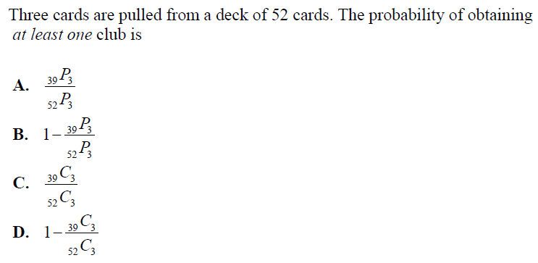
Atleast one club will include the cases with:
1 club, 2 clubs, and 3 clubs
The compliment of this event is not getting any clubs
13 clubs choose none
39 non clubs choose 3
Subtract the compliment from one to get the probability of getting at least one club
D

Slide 22
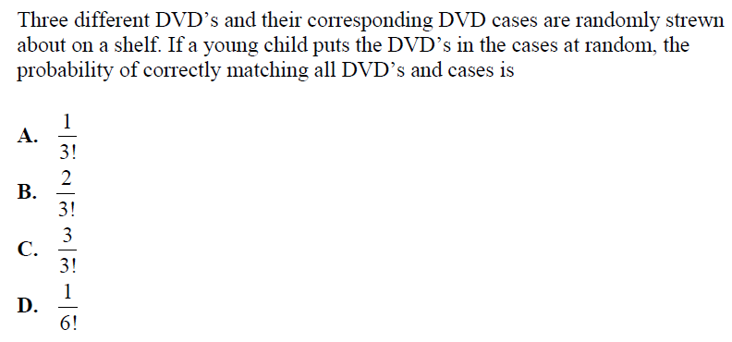
Find the number of ways to arrange the DVD’s in the cases:
A
There’s only one correct way of arranging the DVD’s

Slide 23
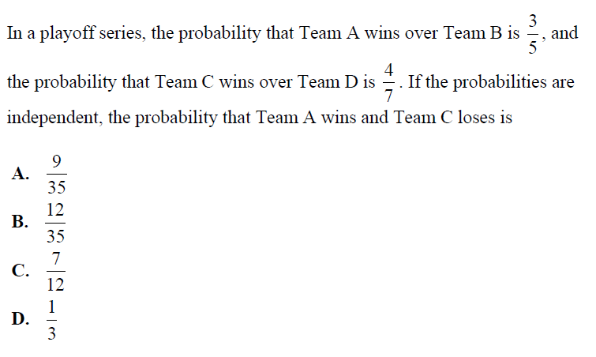
The two events are independent
A

Slide 24
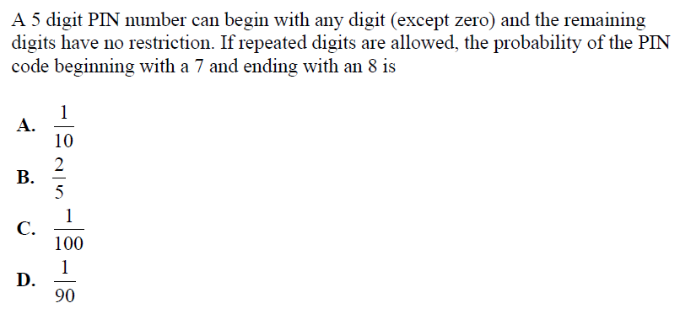
Number of desired outcomes:
Last # is a 7 and the first # is an 8
Total number of outcomes:
D

Slide 25
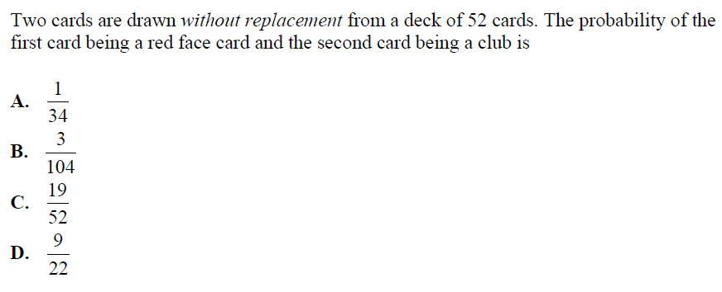
A

Slide 26
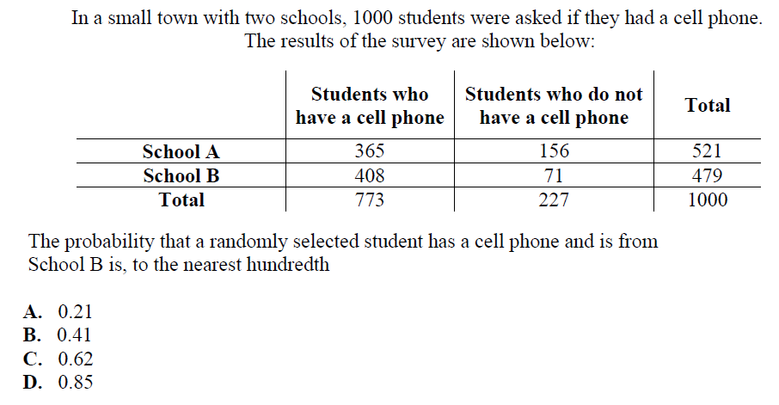
B
Number of students with cell phone and from school B:
Total number of students:

Slide 27
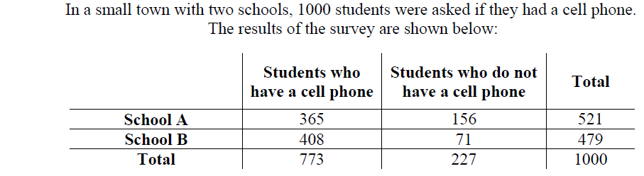
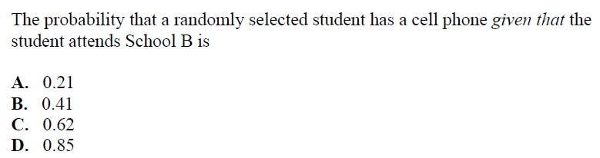
D

Slide 28
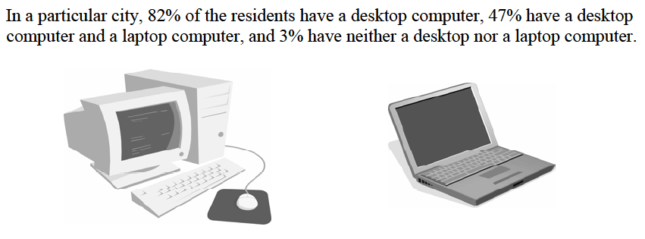
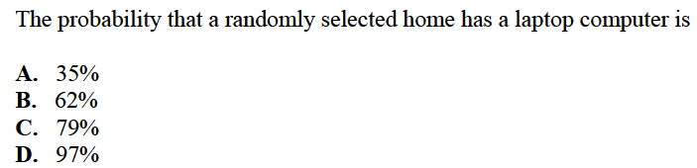
Draw a Venn Diagram with 2 circles:
B
Desktop
Laptop

Slide 29
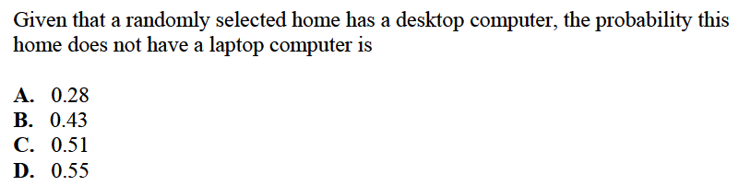
B
Desktop
Laptop

Slide 30
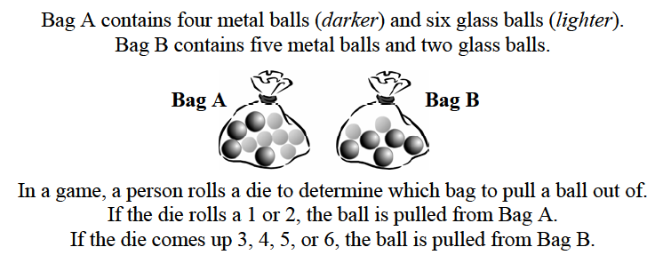
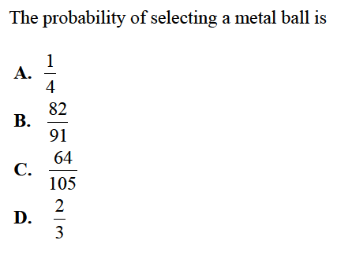
v
C

Slide 31
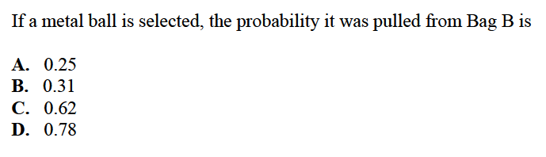
D

Slide 32
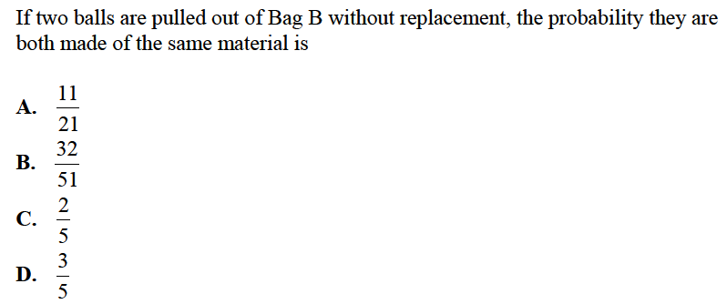
Given that the two balls are from Bag B
The probability that both balls are the same material:
A
Consider the case with both metals or both glass

Slide 33
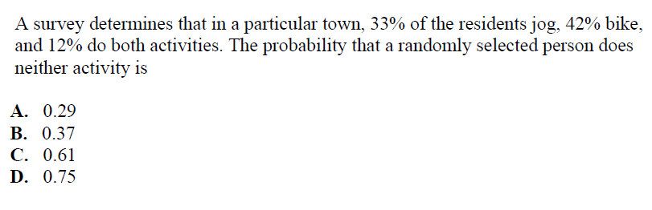
Draw a Venn Diagram with 2 circles:
B
Jogs
Bikes

